Slide 1
Discrete Random Variables and Probability Distributions

Slide 2
LO
Describe a discrete random variable
Check if a function is a probability mass function and use it to calculate probability
Find the cumulative distribution function of a discrete random variable
Compute the mean and variance of a discrete random variable
Determine the probability, mean and variance of uniform, binomial, geometric and negative binomial, hypergeometric and Poisson distributions

Slide 3
X = number of trials until the 1st success
X = number of successes
in a series of n Bernoulli trials
Geometric
Distribution
Binomial
Distribution
X = number of successes
in sample of size n from N objects
Hyper-
-geometric
Distribution
Discrete
RV
Uniform
Distribution
P(X = x_{i}) = 1/n
for i =1, …, n
Negative
Binomial
Distribution
Poisson
Distribution
X = number of trials until having r successes
X = number of rare events

Slide 4
Random Variables
A random variable is a function that assigns a real number to each outcome in the sample space of a random experiment.
X : S → 
X(ω) ∈ 
If X(S) = {x₁, x₂, …, x_{n}} or X(S) = {x₁, x₂, …, x_{n}, …},
X is called discrete.

Slide 5
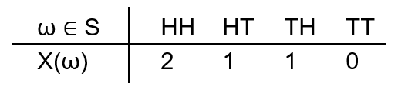
Random variables – Ex
Flipping a coin twice.
The sample space is S = {HH, HT, TH, TT}.
X : S → 
X(ω) = number of heads in each outcome ω
Discrete random variable

Slide 6
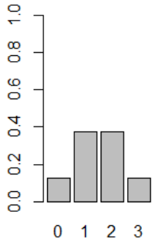
Probability Distribution – Ex1
Toss a fair coin three times and let X be the number of Heads observed, X(ω) ∈ {0, 1, 2, 3}. Then we have the following probabilities
HTT THT TTH
HHT HTH THH
TTT
HHH
X | 0 | 1 | 2 | 3
P(X = x) | 1/8 | 3/8 | 3/8 | 1/8
Probability distribution for number of heads.
Σ_{x}P(x) = 1

Slide 7
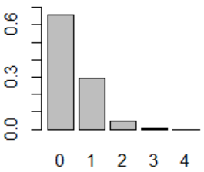
Probability Distribution
The probability distribution of a random variable X is a description of the probabilities associated with the possible values of X.
Ex. (Digital Channel) There is a chance that a bit transmitted through a digital transmission channel is received in error. Let X equal the number of bits in error in the next four bits transmitted. The possible values for X are {0, 1, 2, 3, 4}. Suppose that the probabilities are
X | 0 | 1 | 2 | 3 | 4
P(X = x) | 0.6561 | 0.2916 | 0.0486 | 0.0036 | 0.0001
Probability distribution for bits in error.

Slide 8
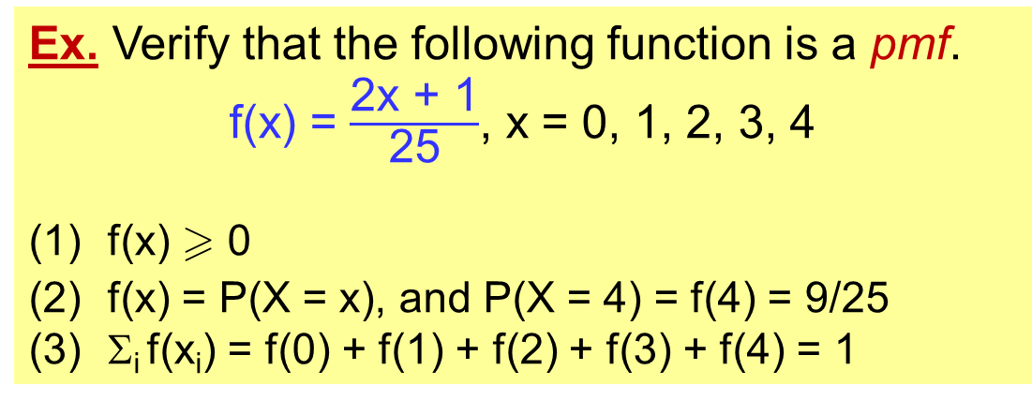
Probability Mass Functions (pmf)
For a discrete random variable X with possible values x₁, x₂, …, x_{n}, a probability mass function is a function f such that
f(x_{i})  0
f(x_{i}) = P(X = x_{i})
Σ_{i} f(x_{i}) = 1
Ex. Verify that the following function is a pmf.
f(x) = $\frac{\text{2}\text{x}\text{ + 1}}{\text{2}\text{5}}$, x = 0, 1, 2, 3, 4
f(x)  0
f(x) = P(X = x), and P(X = 4) = f(4) = 9/25
Σ_{i} f(x_{i}) = f(0) + f(1) + f(2) + f(3) + f(4) = 1

Slide 9
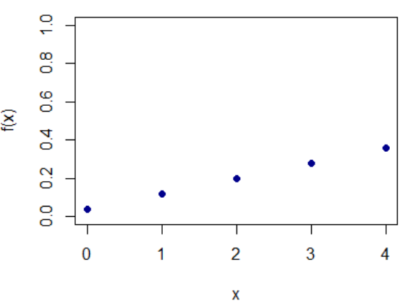
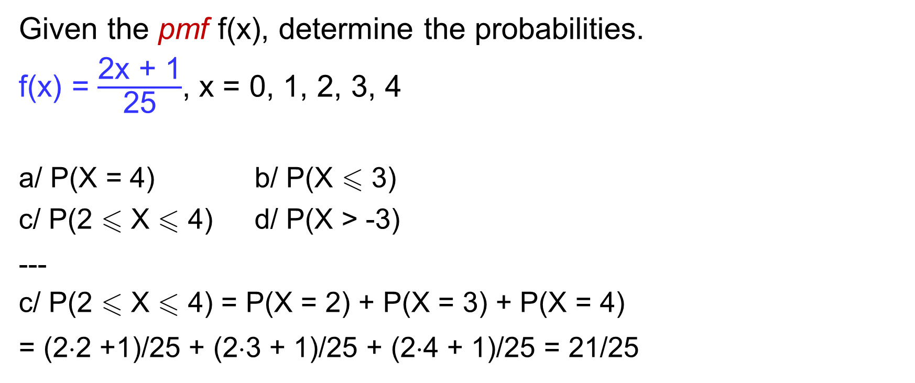
Probability Mass Functions (pmf) - Ex
Given the pmf f(x), determine the probabilities.
f(x) = $\frac{\text{2}\text{x}\text{ + 1}}{\text{2}\text{5}}$, x = 0, 1, 2, 3, 4
a/ P(X = 4) b/ P(X  3)
c/ P(2  X  4) d/ P(X > -3)
---
c/ P(2  X  4) = P(X = 2) + P(X = 3) + P(X = 4)
= (2⋅2 +1)/25 + (2⋅3 + 1)/25 + (2⋅4 + 1)/25 = 21/25

Slide 10

Cumulative Distribution Function (cdf)
The cumulative distribution function (cdf) of a discrete random variable X, denoted as F(x), is
F(x) = P(X  x)
For discrete random variable X, F(x) satisfies
F(x) = $\sum_{\text{x}\text{i} \text{ }\text{x}}{\text{f}\text{(}\text{xi}\text{)}}$
0  F(x)  1
If x  y, then F(x)  F(y)
x | -1 | 0 | 1 | 2 | otherwise
f(x) | 0.2 | 0.4 | 0.1 | 0.3 | 0
Find F(-1), F(1), F(1.9)
---------
F(-1) = 0.2, F(1) = f(-1) + f(0) + f(1) = 0.7
F(1.9) = f(-1) + f(0) + f(1) = 0.7

Slide 11
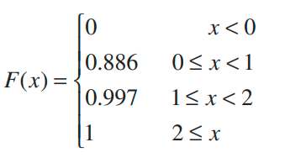
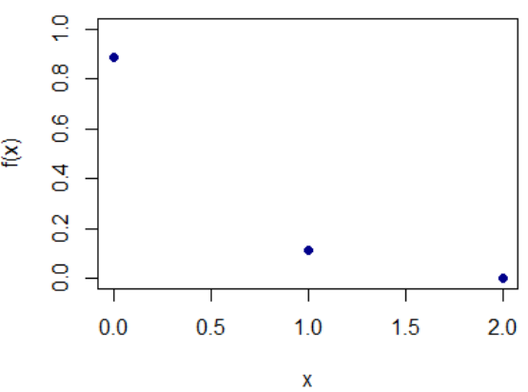
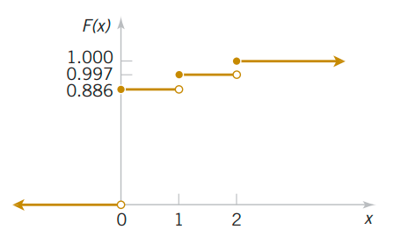
Pmf vs cdf
x | 0 | 1 | 2
f(x) | 0.886 | 0.111 | 0.003
Probability mass function pmf
Cumulative distribution function cdf

Slide 12
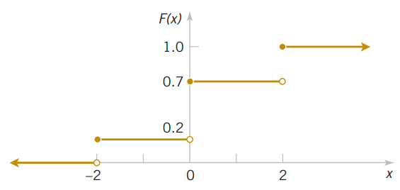
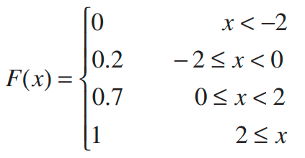
Cdf - Ex
Determine the pmf of X from the following cdf
x | -3 | -2 | -1 | 0 | 1 | 2 | 3
F(x) | 0 | 0.2 | 0.2 | 0.7 | 0.7 | 1 | 1
f(x) | 0 | 0.2 | 0 | 0.5 | 0 | 0.3 | 0
Find f(x) from F(x):
f(x) = F(x) – F(x⁻)

Slide 13
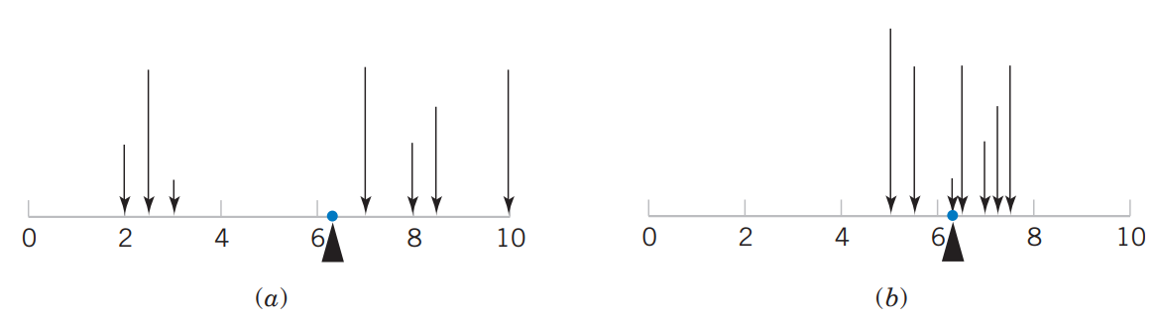
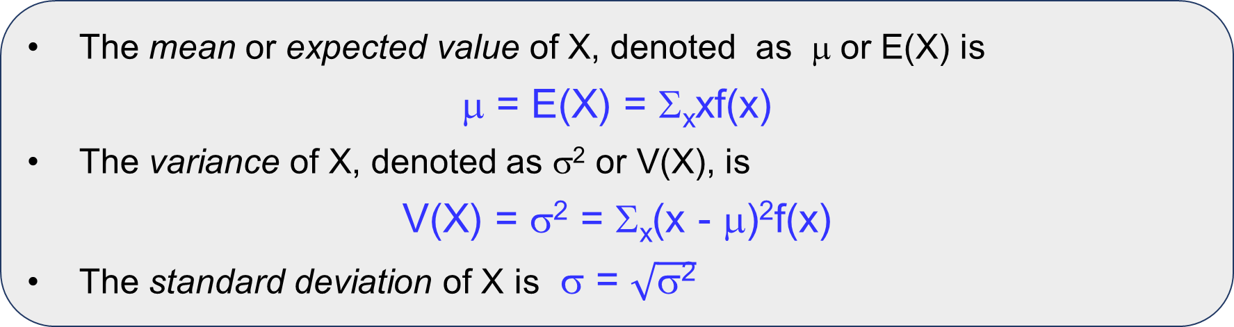
Mean and Variance
The mean or expected value of X, denoted as μ or E(X) is
μ = E(X) = Σ_{x}xf(x)
The variance of X, denoted as σ² or V(X), is
V(X) = σ² = Σ_{x}(x - μ)²f(x)
The standard deviation of X is σ = $\sqrt{\text{σ}\text{2}}$
Large variance
Small variance
Parts (a) and (b) illustrate equal means, but Part (a) illustrates a larger variance

Slide 14
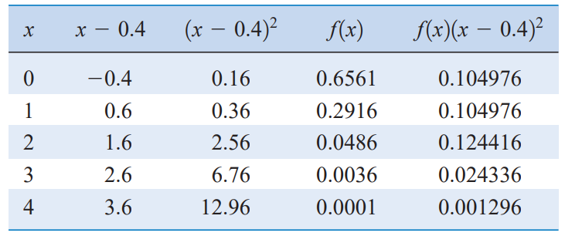
Mean and Variance - Ex
Ex. (Digital Channel) There is a chance that a bit transmitted through a digital transmission channel is received in error. Let X equal the number of bits in error in the next four bits transmitted. Suppose that the probabilities are
x | 0 | 1 | 2 | 3 | 4
f(x) = P(X = x) | 0.6561 | 0.2916 | 0.0486 | 0.0036 | 0.0001
μ = E(X)
= Σ_{x}xf(x) = 0.4
σ² = V(X)
= Σ_{x}(x - μ)²f(x) = 0.36
Notes:
x<-c(0:4)
fx<-c(0.6561,0.2916,0.0486,0.0036,0.0001)

Slide 15
Mean and Variance - Ex
Ex. Given the pmf of a discrete r. v. X.
Find E(X), V(X).
---
E(X) = 0*0.5 + 1*0.3 + 2*0.1 + 3*0.1 = 0.8
V(X) = 0.5*(0 – 0.8)² + 0.3*(1 – 0.8)² + 0.1*(2 – 0.8)² + 0.1*(3 – 0.8)² = 0.96
x | 0 | 1 | 2 | 3
f(x) | 0.5 | 0.3 | 0.1 | 0.1

Slide 16
Expected Value of a Function of a Discrete Random Variable
If X is a discrete random variable with probability mass function f(x),
E[h(X)] = Σ_{x}h(x)f(x)
x | 0 | 1 | 2 | 3
f(x) | 0.5 | 0.3 | 0.1 | 0.1
Ex. Given the pmf of a discrete r. v. X.
Find E(X), E(X + 2), E(3X), E(3X + 2), E(X²)
E(X²) = 0²(0.5) + 1²(0.3) + 2²(0.1) + 3²(0.1) = 1.6

Slide 17
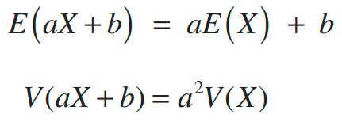
Some Useful properties
σ² = V(X)
= Σ_{x}(x - μ)²f(x)
= E[(X- μ)²]
= E[X² - 2μX + μ²]
= E(X²) – μ²
= E(X²) – E(X)²

Slide 18
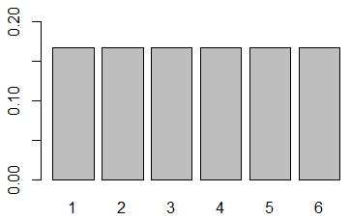
Discrete Uniform Distribution
A random variable X has a discrete uniform distribution if each of the n values in its range, say x₁, x₂, …, x_{n}, has equal probability. Then,
f(x_{i}) = 1/n
Ex. Roll a fair die.
Let X be the number shown.
Then X is discrete uniform range of 1 to 6.
f(1) = f(2) = … = f(6) = 1/6

Slide 19
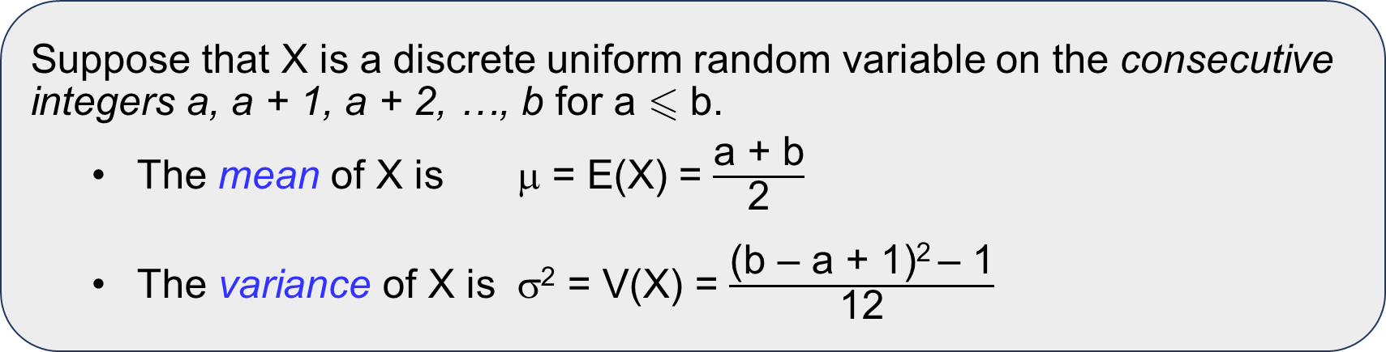
Discrete Uniform Distribution
Suppose that X is a discrete uniform random variable on the consecutive integers a, a + 1, a + 2, …, b for a  b.
The mean of X is μ = E(X) = $\frac{\text{a}\text{ + }\text{b}}{\text{2}}$
The variance of X is σ² = V(X) = $\frac{\text{(}\text{b}\text{ – }\text{a}\text{ + 1)2 – 1}}{\text{12}}$
Ex. Suppose the discrete uniform random variable Y has range 5, 10, …, 30.
Let Y = 5X, where X has range 1, 2, …, 6. Then,
E(Y) = 5E(X) = 5(1 + 6)/2 = 17.5,
V(Y) = 5²V(X) = 25[(6 – 1 + 1)² – 1]/12 = 72.92

Slide 20
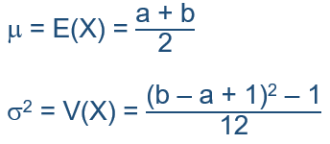
Discrete Uniform Distribution – Ex
Thickness measurements of a coating process are made to the nearest hundredth of a millimeter. The thickness measurements are uniformly distributed with values 0.15, 0.16, 0.17, 0.18, and 0.19. Determine the mean and variance of the coating thickness for this process.

Slide 21
Bernoulli trials
Bernoulli trial: A trial with only two possible outcomes (success or failure).
Ex. The following random experiments are series of Bernoulli trials:
Flip a coin 10 times.
Guess each question of a multiple-choice exam with 50 questions, each with four choices.
Independence: The outcome from one trial has no effect on the outcome to be obtained from any other trial.

Slide 22
Bernoulli trials – Ex
For each question of a quiz, without preparation, you select at random an answer from 4 options. Suppose the quiz has 5 questions.
What is the probability that you get 2 correct answers?

Slide 23
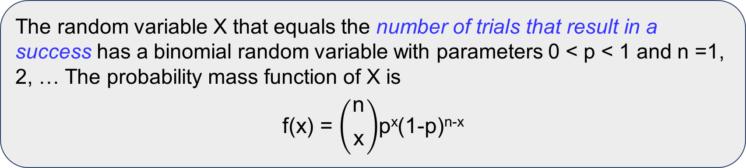
Binomial Distribution (bi = two: two outcomes {success, failure})
A random experiment consists of n Bernoulli trials such that
The trials are independent.
Each trial results in only two possible outcomes, labeled as “success’’ and “failure’’.
The probability of a success in each trial, denoted as p, remains constant.
The random variable X that equals the number of trials that result in a success has a binomial random variable with parameters 0 < p < 1 and n =1, 2, … The probability mass function of X is
f(x) = $\left({\begin{aligned}\text{n} \\ \end{aligned} \atop \text{x}}\right)$p^{x}(1-p)^{n-x}
Notes:
dbinom(k,n,p) for P(X = k)
pbinom(k,n,p) for P(X ≤ k)
rbinom(k,n,p) Simulates k random variables

Slide 24
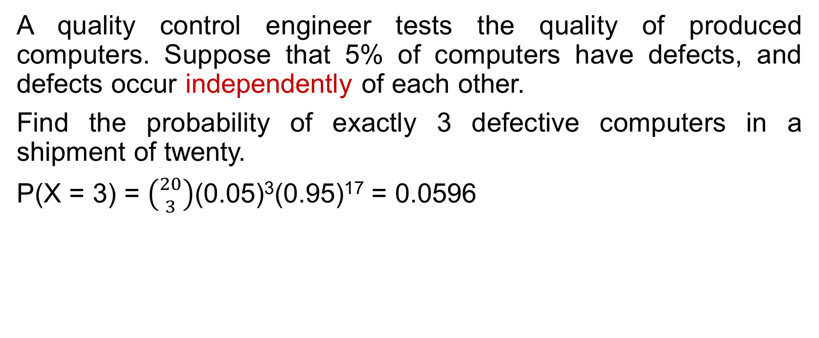
Binomial Distribution – Ex
A quality control engineer tests the quality of produced computers. Suppose that 5% of computers have defects, and defects occur independently of each other.
Find the probability of exactly 3 defective computers in a shipment of twenty.
P(X = 3) = $\left({20 \atop 3}\right)$(0.05)³(0.95)¹⁷ = 0.0596
Notes:
k<-3
n<-20
p<-0.05
dbinom(k,n,p)

Slide 25
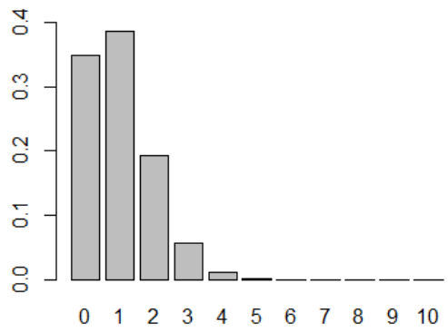
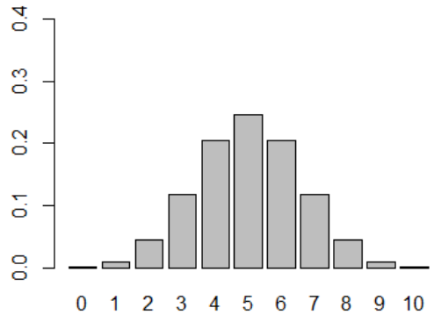
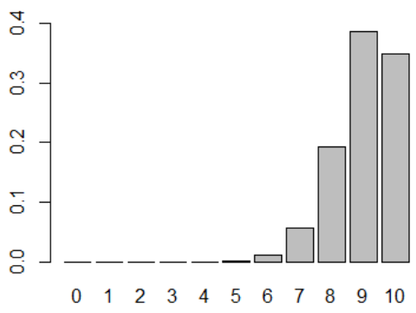
Binomial distribution – selected n and p
n = 10
p = 0.1
n = 10
p = 0.5
n = 10
p = 0.9
Notes:
n <- 10
p <- 0.1
barplot(dbinom(0:n,n,p), names.arg=0:n)

Slide 26
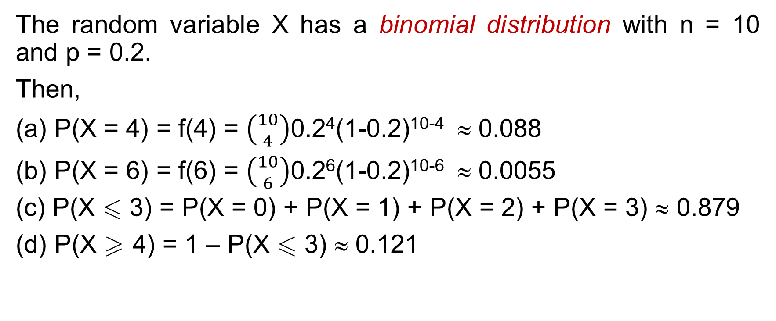
Binomial distribution – R-Ex
The random variable X has a binomial distribution with n = 10 and p = 0.2.
Then,
(a) P(X = 4) = f(4) = $\left({10 \atop 4}\right)$0.2⁴(1-0.2)¹⁰⁻⁴ ≈ 0.088
(b) P(X = 6) = f(6) = $\left({10 \atop 6}\right)$0.2⁶(1-0.2)¹⁰⁻⁶ ≈ 0.0055
(c) P(X  3) = P(X = 0) + P(X = 1) + P(X = 2) + P(X = 3) ≈ 0.879
(d) P(X  4) = 1 – P(X  3) ≈ 0.121
Notes:
dbinom(k,n,p) for P(X = k)
pbinom(k,n,p) for P(X ≤ k)
rbinom(k,n,p) Simulates k random variables

Slide 27
Binomial Distribution - Mean and Variance
If X is a binomial random variable with parameters p and n,
μ = E(X) = np and σ² = V(X) = np(1 – p)
R-Ex. A lab network consisting of 20 computers was attacked by a computer virus. This virus enters each computer with probability 0.4, independently of other computers. Find the expected number of computers attacked by this virus.
Let X = “number of computers attacked by the virus”
➔ X ~ binom(n=20, p=0.4)
➔ E(X) = np = 20(0.4) = 8 computers
Notes:
table(rbinom(1000,20,0.4))
mean(rbinom(1000,20,0.4))

Slide 28
Exercise
A company is interested in evaluating its current inspection procedure on large shipments of identical items. The procedure is to take a sample of 5 items and pass the shipment if no more than 1 item is found to be defective. It is known that items are defective at a 10% rate overall.
What is the probability that the inspection procedure will pass the shipment?
What is the expected number of defectives in this process of inspecting 5 items?

Slide 29
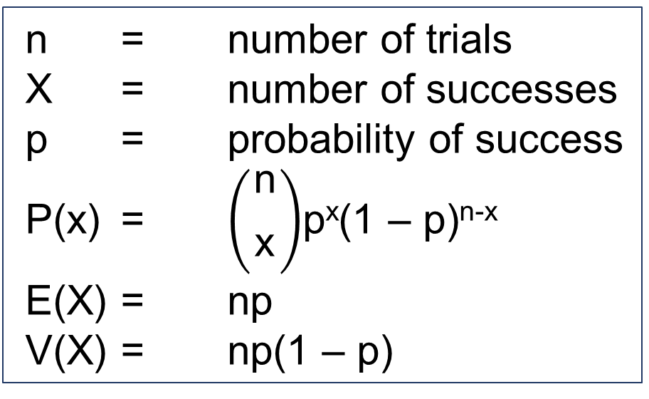
Binomial distribution
n = number of trials
X = number of successes
p = probability of success
P(x) = $\left({\begin{aligned}\text{n} \\ \end{aligned} \atop \text{x}}\right)$p^{x}(1 – p)^{n-x}
E(X) = np
V(X) = np(1 – p)
Binomial
Distribution

Slide 30
Geometric Distribution
In a series of Bernoulli trials (independent trials with constant probability p of a success), let the random variable X denote the number of trials until the first success. Then X is a geometric random variable with parameter 0 < p < 1 and
P(the 1st success occurs on the x-th trial) is
f(x) = (1 - p)^{x-1}p, x = 1, 2, …
x-1 trials with failures
the last trial (x-th trial) with a success
Ex. A search engine goes through a list of sites looking for a given key phrase. Suppose the search terminates as soon as the key phrase is found. The number of sites visited has geometric distribution.
Notes:
dgeom(k,p)
pgeom(k,p)
rgeom(n,p),
where k represents the number of failures BEFORE the first success.
use the following modifications:
dgeom(k-1,p)
pgeom(k-1,p)
rgeom(n,p)+1

Slide 31
Geometric Distribution - Ex
The probability that a bit transmitted through a digital transmission channel is received in error is 0.1. Assume the transmissions are independent events, and let the random variable X denote the number of bits transmitted until the first error. Find P(X = 5)
P(X = 5) = P(OOOOE) = 0.9⁴0.1 = 0.0656
O: Okey bit
E: error bit
Notes:
dgeom(4,0.1)

Slide 32
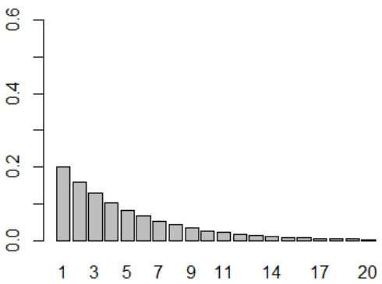
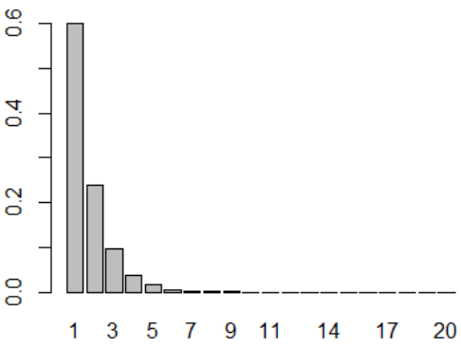
Geometric Distribution
p = 0.2
p = 0.6
Notes:
n <- 10
p <- 0.9
barplot(dgeom(0:(n-1),p), names.arg=1:n,ylim=c(0,1))

Slide 33
Geometric Distribution – Mean & Variance
If X is a geometric random variable with parameter p,
μ = E(X) = 1/p and σ² = V(X) = (1 – p)/p²

Slide 34



Ex. Geometric Distribution - Mean
The probability that a bit transmitted through a digital transmission channel is received in error is 0.1. Assume the transmissions are independent events, and let the random variable X denote the number of bits transmitted until the first error. What is the expected number of bits transmitted until the first error?
E(X) = 1/p = 10 bits
Notes:
Simulation in R:
rgeom(3,p)+1 # mo phong 3 lan, quan sat thanh cong o lan thu nghiem thu may
table(rgeom(1000,0.1)+1)
mean(rgeom(1000,0.2)+1)

Slide 35

Geometric Distribution - Variance
Ex. The probability that a bit transmitted through a digital transmission channel is received in error is 0.1. Assume the transmissions are independent events, and let the random variable X denote the number of bits transmitted until the first error.
σ² = V(X) = (1 – p)/p² = (1 – 0.1)/(0.1)² ➔ σ = 9.49
Practical Interpretation when p is small:
σ ≈ μ = 1/p, which is large
The number of trials until the first success
may be much different from the mean.
Notes:
rgeom(n,p) + 1

Slide 36
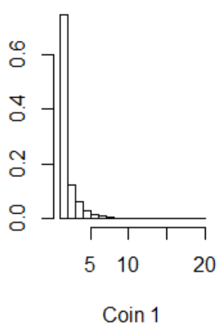
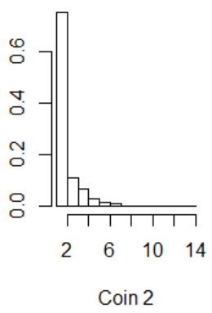
Lack of Memory Property
> n <- 100000
> coin1 <- rgeom(n,1/2)+1
> coin <- rgeom(n,1/2)+1
> coin2 <-coin[coin>5]-5
> mean(coin1)
[1] 2.0053
> mean(coin2)
[1] 1.996479
> par(mfrow=c(1,2))
> hist(coin1,prob=T, xlab='Coin 1')
> hist(coin2,prob=T, xlab ='Coin 2')
The coin is memoryless

Slide 37
Geometric Distribution
X = number of trials until first success
p = probability of success
P(x) = p(1 – p)^{x-1}, x = 1, 2, …
E(X) = 1/p
V(X) = (1 – p)/p²
Geometric
Distribution
Notes:
P(X > k) = (1-p)^k

Slide 38
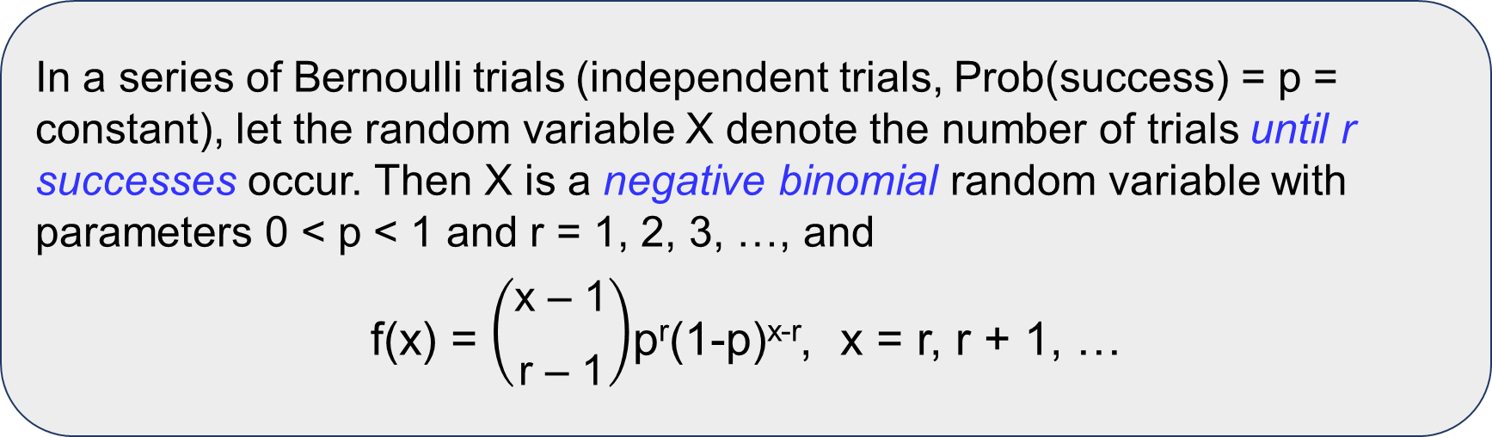
Negative Binomial Distribution
In a series of Bernoulli trials (independent trials, Prob(success) = p = constant), let the random variable X denote the number of trials until r successes occur. Then X is a negative binomial random variable with parameters 0 < p < 1 and r = 1, 2, 3, …, and
f(x) = $\left({\begin{aligned}\text{x}\text{ – 1} \\ \end{aligned} \atop \text{r}\text{ – 1}}\right)$p^{r}(1-p)^{x-r}, x = r, r + 1, …
r = 1: a negative binomial distribution becomes a geometric distribution
Notes:
The R commands are dnbinom(k,r,p) for P(X = k), pnbinom(k,r,p), rnbinom(n,r,p)
where k represents the number of failures BEFORE r successes.
Use the following modifications to work with the number of trials required for the first r successes.
dnbinom(k-r,r,p)
pnbinom(k-r,r,p)
rnbinom(n,r,p)+r

Slide 39
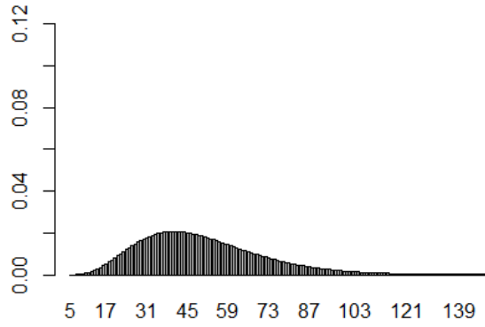
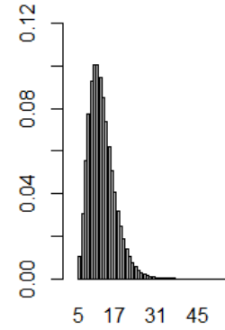
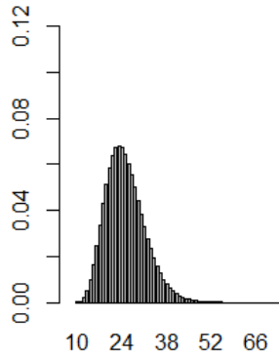
p = 0.1
r = 5
p = 0.4
r = 5
p = 0.4
r = 10
Smaller value of p, larger number of trials
Larger value of r, larger number of trials
Notes:
n <- 150
p <- 0.4
barplot(dnbinom(0:(n-10),10,p), names.arg=10:n,xlim=c(0,150), ylim=c(0,0.12))

Slide 40
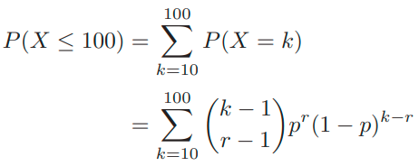

Negative binomial distribution – Ex
Ex. Applicants for a new student internship are accepted with probability p = 0.2 independently from person to person. Several hundred people are expected to apply. Find the probability that it will take no more than 100 applicants to find 10 students for the program.
Let X be the number of people who apply for the internship until the 10th student is accepted. Then X has a negative binomial distribution with parameters r = 10 and p = 0.2.
The desired probability is
Notes:
pnbinom(100-10,10,0.2)

Slide 41
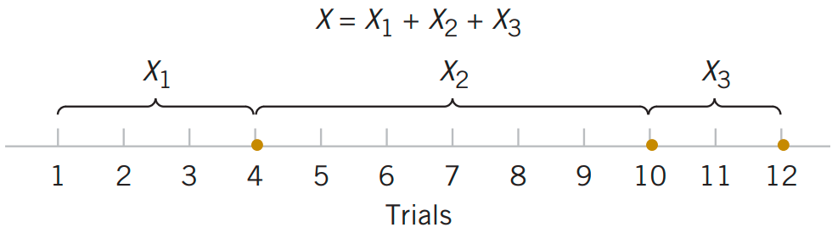
Negative binomial distribution
If X is a negative binomial random variable with parameters p and r,
μ = E(X) = rp and σ² = V(X) = r(1 – p)/p²
Negative binomial random variable represented as a sum of geometric random variables.

Slide 42
Negative binomial distribution
If X is a negative binomial random variable with parameters p and r,
μ = E(X) = rp and σ² = V(X) = r(1 – p)/p²
Ex. (Web Servers) A Web site contains three identical computer servers. Only one is used to operate the site, and the other two are spares that can be activated in case the primary system fails. The probability of a failure in the primary computer (or any activated spare system) from a request for service is 0.0005. Assuming that each request represents an independent trial, what is the mean number of requests until failure of all three servers?
E(X) = r/p = 3/(0.0005) = 6000 requests.

Slide 43
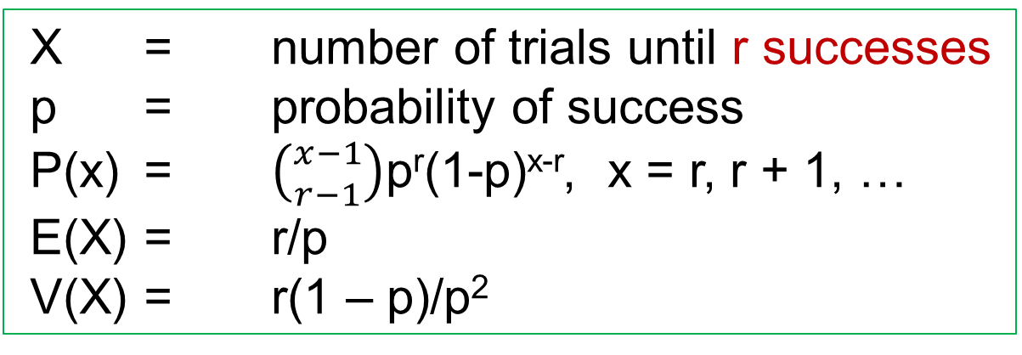
Negative Binomial Distribution
X = number of trials until r successes
p = probability of success
P(x) = $\left({x−1 \atop r−1}\right)$p^{r}(1-p)^{x-r}, x = r, r + 1, …
E(X) = r/p
V(X) = r(1 – p)/p²
Negative
Binomial
Distribution
Notes:
P(X > k) = (1-p)^k
P(X <= k) = 1 – (1-p)^k

Slide 44
Hypergeometric Distribution
A set of N objects contains
K objects classified as successes
N – K objects classified as failures
A sample of size n objects is selected randomly (without replacement) from the N objects.
Let X denote the number of successes in the sample. Then X is a hypergeometric random variable and
for max{0, n – (N – K)}  x  min{n, K}
Notes:
The R commands are
dhyper(x,K,N-K, n)
phyper(x,K,N-K, n)
rhyper(repeats,x,K,N-K,n)

Slide 45
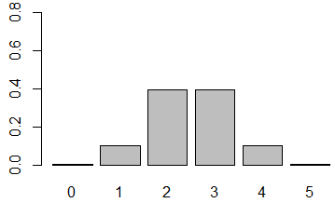
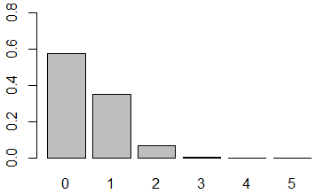
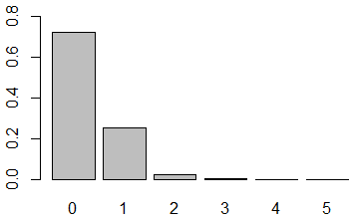
Hypergeometric Distribution – Selected cases
N = 10, K = 5, n = 5
N = 50, K = 5, n = 5
N = 50, K = 3, n = 5
Notes:
N<-50
K<-5
n<-5
barplot(dhyper(0:5,K,N-K, n), names.arg=0:5,ylim=c(0,0.8))

Slide 46
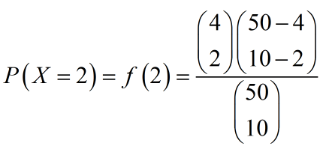

Hypergeometric Distribution - Ex
Ex. A shipment of 50 computers contains 4 defective ones. Ten are bought at random. What is the probability that two of them will be defective?
X = the number of defective computers
➔ X is a hypergeometric random variable with parameters N = 50, K = 4, n = 10.
The desired probability is
Notes:
dhyper(2,4,50-4,10)

Slide 47
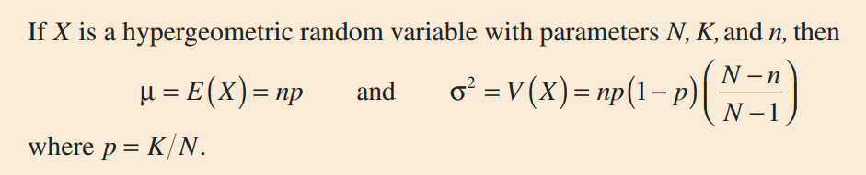
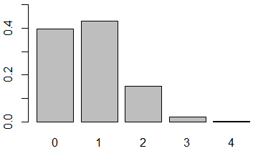
Hypergeometric Distribution
finite population correction factor
p: the proportion of successes in the set of N objects
Ex. In the previous example, n = 10, p = 4/50.
E(X) = 10(4/50) = 0.8
and V(X) = 10(4/50)(46/50)(40/49) = 0.601

Slide 48
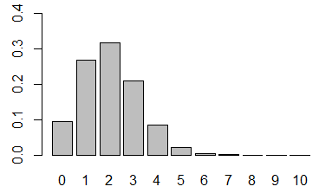
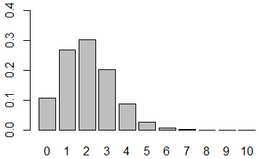
Hypergeometric vs Binomial
n  N, p = K/N is not too close to 0 or 1
Hypergeometric distribution Binomial Distribution
N = 100, K = 20, n = 10 p = K/N = 0.2, n = 10
Notes:
N<-100
K<-20
n<-10
dhyper(0:10,K,N-K, n)
n<-10
p <-0.2
dbinom(0:n,n,p)

Slide 49
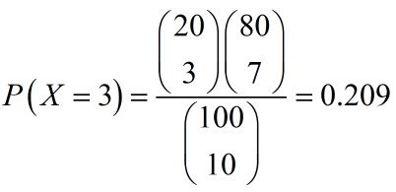
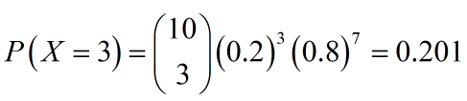
Binomial distribution approximates Hypergeometric Distribution - Ex
Ex. Suppose a shipment of 100 computers contains 20 defective ones. Ten are selected at random. Find the probability that 3 of them will be defective.
Use hypergeometric distribution (N = 100, K = 20, n = 10):
Use binomial distribution (10 = n N = 100, p = 20/100 = 0.2):

Slide 50
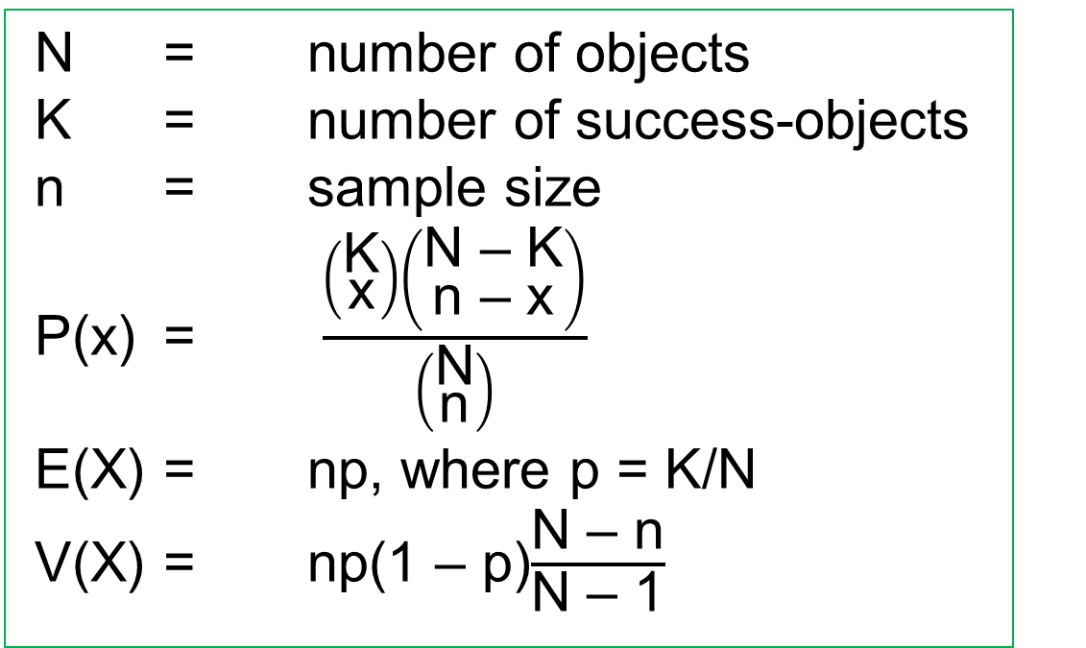
Hypergeometric Distribution
N = number of objects
K = number of success-objects
n = sample size
P(x) = $\frac{\left({\text{K} \atop \text{x}}\right)\left({\text{N}\text{ – }\text{K} \atop \text{n}\text{ – }\text{x}}\right)}{\left({\text{N} \atop \text{n}}\right)}$
E(X) = np, where p = K/N
V(X) = np(1 – p)$\frac{\text{N}\text{ – }\text{n}}{\text{N}\text{ – 1}}$
Hypergeometric
Distribution
Notes:
P(X > k) = (1-p)^k

Slide 51
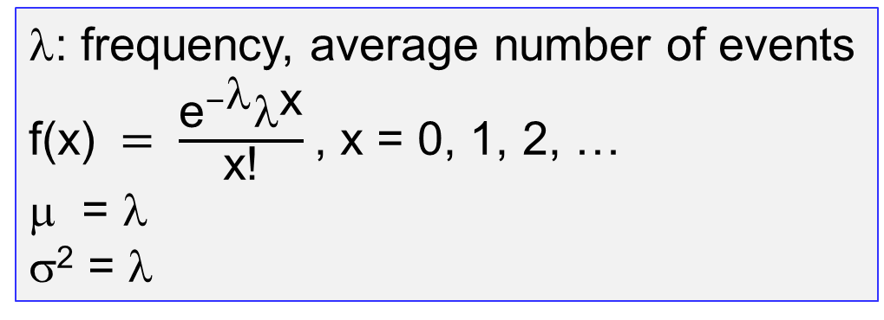
Poisson Distribution
The number of rare events occurring within a fixed period of time has Poisson distribution with parameter λ > 0.
λ: frequency, average number of events
$\text{f}\text{(}\text{x}\text{)} = \frac{{\text{e}}^{−λ}λ^{\text{x}}}{\text{x}\text{!}}$, x = 0, 1, 2, …
μ = λ
σ² = λ
Poisson
Distribution
Examples of rare events: telephone calls, e-mail messages, traffic accidents, network blackouts, virus attacks, errors in software, floods, earthquakes, soldiers killed by horse kick, etc.
Notes:
Commands for working with the Poisson distribution are
dpois(x,lambda)
ppois(x,lambda)
rpois(n,lambda)

Slide 52
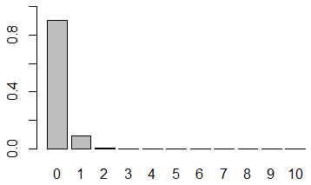


Poisson Distribution
λ = 0.1
λ = 2
λ = 5
Poisson distributions for selected values of the parameters.

Slide 53

Poisson Distribution - Ex
(New accounts) The number of new accounts of an internet service provider has a Poisson distribution with a mean of 5 accounts per day.
a/ What is the probability that there more than 4 new accounts in one day?
b/ What is the probability that there are 15 new accounts in 2 days?
a/ P(X > 4) = 1 – P(X  4) = 1 – P(X = 0) – P(X = 1) – P(X = 2) – P(X = 3) – P(X = 4) = 0.56
b/ Let X denote the number of new accounts in 2 days. Then X has a Poisson distribution with $$ = E(X) = 2(5) = 10.
P(X = 15) = $\frac{e^{−λ}λ^{x}}{x!}$= $\frac{e^{−10}{10}^{15}}{15!}$= 0.0347

Slide 54
Poisson Distribution – Exercises
The number of telephone calls that arrive at a phone exchange is often modeled as a Poisson random variable. Assume that on the average there are 10 calls per hour.
What is the probability that there are exactly five calls in one hour?
What is the probability that there are three or fewer calls in one hour?
What is the probability that there are exactly 15 calls in two hours?
What is the probability that there are exactly five calls in 30 minutes?

Slide 55


Poisson approximation to Binomial
Poisson distribution (λ = np) can be effectively used to approximate Binomial probabilities when
n is large (e.g., n  30)
p is small (e.g., p  0.05)
Binom(n = 30, p = 0.03)
Pois(λ = np = 0.9)
Notes:
n<-30
p <-0.03
barplot(dbinom(0:n,n,p), names.arg=0:n,ylim=c(0,0.4))
barplot(dpois(0:n,n*p), names.arg=0:n,ylim=c(0,0.4))

Slide 56

Poisson approximation to Binomial
Ex. 3% of messages are transmitted with errors. What is the probability that out of 200 messages, exactly 5 will be transmitted incorrectly?
Let X be the number of messages with errors.
X ~ Binom(n = 200, p = 0.03) and P(X = 5) = 0.162
Use Poisson distribution with λ = np = 6:
P(X = 5) = $\frac{{\text{e}}^{−\text{6}}{\text{6}}^{\text{5}}}{\text{5}\text{!}}$ = 0.161

Slide 57
Exercise
A publisher of mystery novels tries hard to keep its books free of typographical errors (typos), to the extent that if we select a page at random from any book published by this frm, the probability that we will fnd at least 1 typo is 0.003. Assume that the occurrence of typos on diferent pages are independent events. What is the approximate probability that a 500-page novel has exactly 1 page with typos?

Slide 58
X = number of trials until the 1st success
X = number of successes
in a series of n Bernoulli trials
Geometric
Distribution
Binomial
Distribution
X = number of successes
in sample of size n from N objects
Hyper-
-geometric
Distribution
Discrete
RV
Uniform
Distribution
P(X = x_{i}) = 1/n
for i =1, …, n
Negative
Binomial
Distribution
Poisson
Distribution
X = number of trials until having r successes
X = number of rare events

Slide 59
Review Questions
Determine the distribution of each of the following random variables
a/ Toss n coins, each showing heads with probability p, independently the other tosses. Let X be the total number of heads.
b/ We throw a coin until a head turns up for the second time, where p is the probability that a throw results in a head. Let X be the number of times we have thrown the coin.
c/ There is one error in one of five blocks of a program. To find the error, we test three randomly selected blocks. Let X be the number of errors in these three blocks.
d/ A lab network consisting of 20 computers was attacked by a computer virus. This virus enters each computer with probability 0.4, independently of other computers. Let X denote the number of computers entered by the virus.
e/ Messages arrive at an electronic message center at random times, with an average of 9 messages per hour. Let X be the messages received during the next hour.
f/ Suppose in a certain shipment of 250 Pentium processors there are 17 defective processors. A quality control consultant randomly collects 5 processors for inspection to determine whether or not they are defective. Let X denote the number of defectives in the sample.

Slide 60
THANKS

Slide 61
Exercises
(13x + 17) mod 160
(23x + 27) mod 160
(33x + 37) mod 160

